Slide 1

MEDIA & THE PUBLIC
Week 8 Spiral of silence
Ryan Wang
ryanyang@psu.edu

Slide 2
Strong/Powerful media effect
McQuail’s four phrases model (2005)
WWI - 1930s
1930s – 1960s
Selective exposure
Magic Bullet
Hypodermic Needle
1960s – 1970s
Two-step flow
1970s -
Spiral of silence
Cultivation
Social constructivism
Framing
Agenda setting
Limited media effect
Revisit of strong media effect
Negotiated/transactional media effect

Slide 3
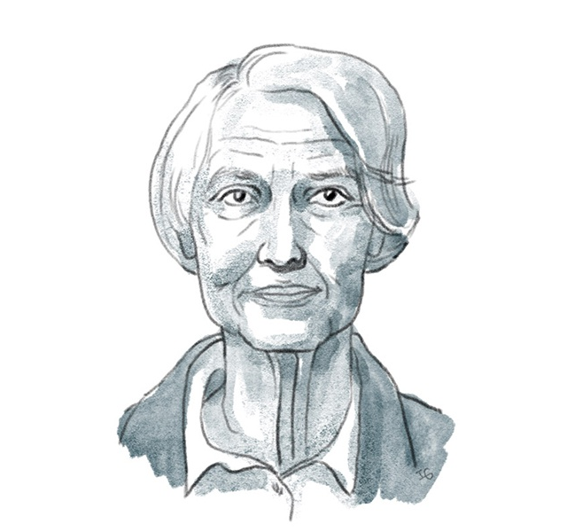
Spiral of Silence Theory
Elisabeth Noelle-Neuman
What is the spiral of silence?
The spiral of silence theory posits that people would be more likely to stay silent about their beliefs if they hold a minority opinion. If minority voices continue to stay silent, the minority opinions will end up extinguishing in public debate, which is known as the process of the spiral of silence (Noelle-Neumann, 2008)

Slide 4
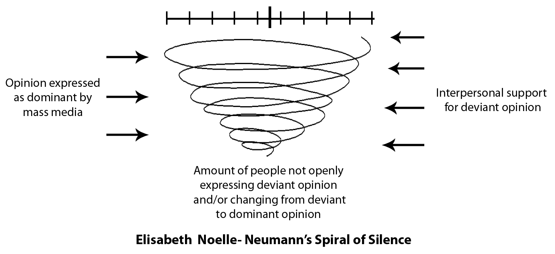
Spiral of Silence Theory
Origins
1965 German federal election campaign
The governing Christian Democratic Union–Christian Social Union (CDU-CSU) and the opposing Social Democratic Party of Germany (SDP), were in a dead heat (45%)
A last-minute swing in favor of the CDU-CSU (45% - 50%), and SDP support rate dropped to less than 40 percent.
CDU-CSU won with 48 percent of the vote, as against 39 percent for the SDP.
Noelle-Neumann: Queen Elizabeth II’s visit to Germany in May 1965, during which she was often accompanied by the Christian Democratic German chancellor, Ludwig Erhard.

Slide 5
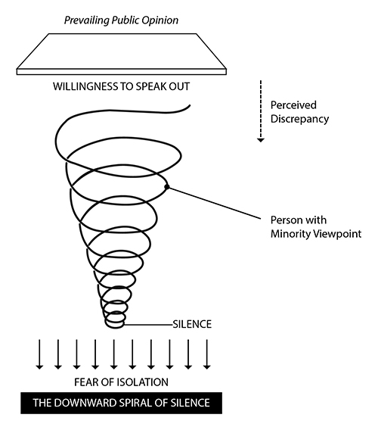
Key elements of Spiral of Silence
We as human being are afraid of Fear of isolation as being isolated from society and also of being ostracized or criticized for failing to go along with the majority relative to specific issues under debate
People tend to monitor the environment and observe other people’s behavior to see whether their own views fit into Opinion climate (especially on controversial topics)
To avoid isolation, people tend to refrain from publicly stating their views on controversial matters when they perceive that doing so would attract criticism, scorn, laughter, or other signs of disapproval.
Meanwhile, those who sense that their opinions will meet with approval tend to voice them fearlessly and at times vociferously
A spiraling process begins, the dominant camp becoming ever louder and more self-confident while the other camp becomes increasingly silent.
One might be encouraged by one peer to speak out personal opinions, even if he/she has the lone opinion toward an issue (Neuwirth & Frederick, 2004).
Notes:
Importantly, the spiral of silence occurs only in connection with controversial issues that have a strong moral component. What triggers a person’s fear of isolation is the belief that others will consider him or her not merely mistaken but morally bad. Accordingly, issues that lack a moral component or on which there is general consensus leave no room for a spiral of silence.

Slide 6
Online versus offline Spiral of Silence
Whether Spiral of Silence operates differently in the offline and online world?
Mass(traditional) media has great authority in creating the information environment, in which people could perceive the opinion climate
Internet has fewer physical constraints, concrete punishment concerns, in an anonymized fashion
Liu & Fahmy (2011): same-sex marriage
Respondents were significantly more likely to report feeling less isolated online than in a real environment
Experiencing fear of online isolation is negatively related to online outspokenness in a virtual environment
Individuals are not necessarily like to speak out their opinions online compared to an offline setting
Hampton et al. (2014): Snowden-NSA story
People were less willing to discuss the Snowden-NSA story in social media than they were in person.
Social media did not provide an alternative discussion platform for those who were not willing to discuss the Snowden-NSA story
In both personal settings and online settings, people were more willing to share their views if they thought their audience agreed with them

Slide 7
Online incivility
Papacharissi (2004): Incivility is speech that threatens democratic norms, such as stereotypes, slurs, and calls to overthrow the government.
Coe et al. (2014); Muddiman (2017); Mutz (2015): Incivility as akin to impoliteness, marked by profanity, name-calling, or insults that make people feel diminished
Rossini (2020): Uncivil discourse is content with foul language or a harsh tone, which she contrasts with the more virulent intolerant speech that attacks individuals or groups
Current study: incivility - impoliteness
It is the most prevalent type of incivility (and more benign comparatively) online
It offers the potentials for discussions while other more virulent types are perceived more harmful and may derail conversations.
It cites negative emotional responses

Slide 8
Chung & Kim (2020): Does online incivility cancel out the spiral of silence? A moderated mediation model o willingness to speak out

Slide 9
Research questions & Hypotheses
H1: People who read uncivil comments will be more likely to speak out if the comments make them angry.
RQ1: Will people who read uncivil comments be more likely to speak out if the comments make them depressed?
H2: People who read uncivil comments that make them either (a) angry or (b) depressed will be more likely to speak out regardless of opinion climate.

Slide 10
Experiment design
Between-subjects multifactorial design
2 (tone: civil vs uncivil)
2 (opinion climate: friendly vs hostile)
2 (stance: pro or anti the topic)
4 (topic: childhood vaccines, HPV vaccine, immigration, climate change)
Mediator: emotions (7-point Likert scale)
Angry
Depress
Dependent variables:
Willingness to speak-out (seven statements; 7-points Likert scale)
Notes:
Manipulation check

Slide 11
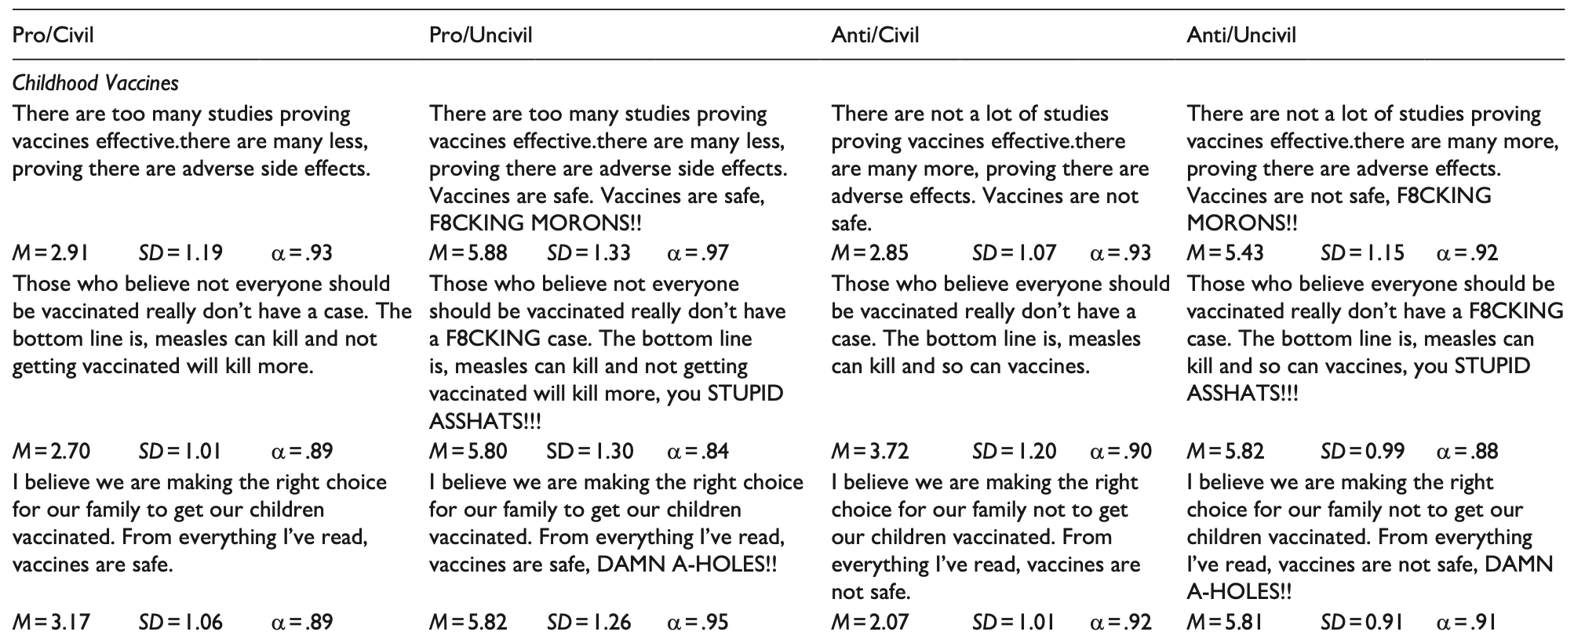
Stimuli

Slide 12

Results
Before hypothesis testing: there are no significant differences across topics and stances on DV
Multifactorial ANOVA
Topics: F (3, 1123) = 2.29, p = .08, $η^{2}$= .006
Stances: F (1, 1123) = 1.94, p = .16, $η^{2}$ = .002.
Results: Topic or stance did not confound our subsequent findings

Slide 13
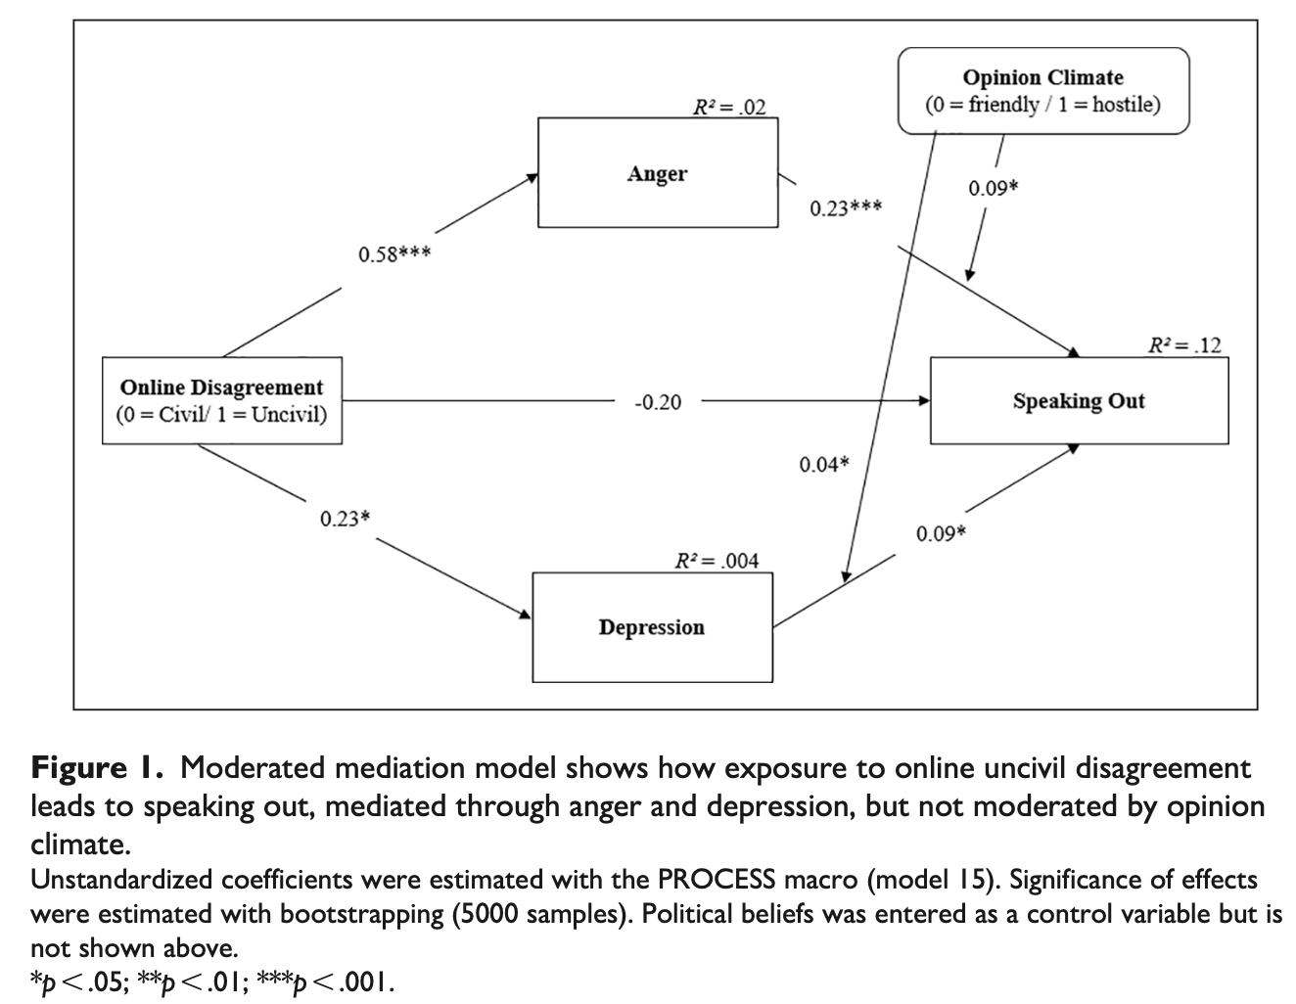
Results

Slide 14
Results
H1: People who read uncivil comments will be more likely to speak out if the comments make them angry. (Supported)
Incivility had an indirect effect on speaking out, mediated through anger for both friendly and hostile opinion climates
However, here was no significant difference between the hostile and friendly conditions
RQ1: Will people who read uncivil comments be more likely to speak out if the comments make them depressed? (YES)
People exposed to uncivil comments had increased feelings of depression, which led to greater likelihood to speak out
The indirect effect only happened in the hostile condition
H2: People who read uncivil comments that make them either (a) angry or (b) depressed will be more likely to speak out regardless of opinion climate. (Supported)
Opinion climate does not moderate the relationship between (a) angry or (b) depressed and the willingness to speak out

Slide 15
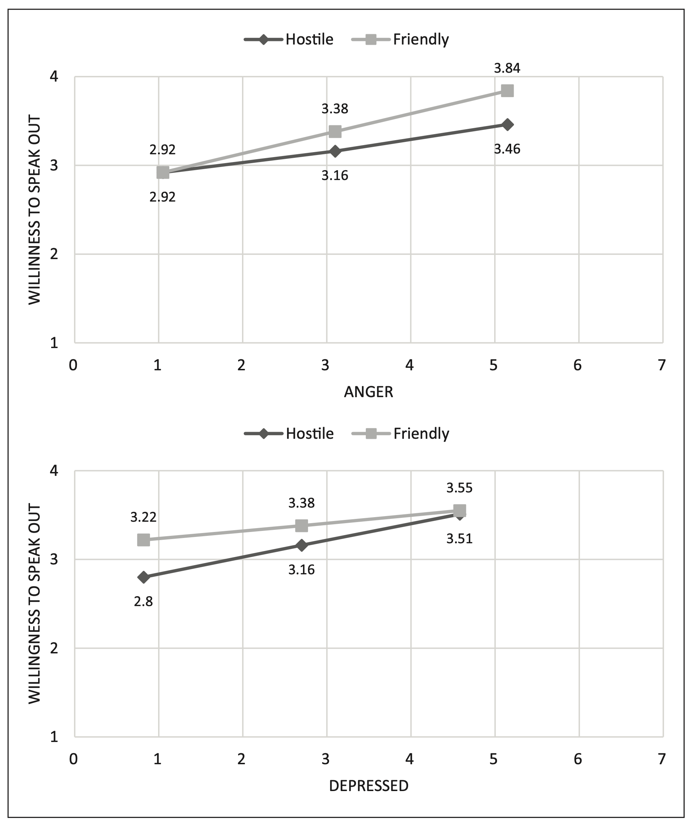
Results

Slide 16
Key takeaways
A new exception of Spiral of Silence theory?
When people were exposed to uncivil online comments, they got both angry and depressed, and they were more likely to have an intention to speak out regarding the topic of the comments
If people felt intense feelings of anger or depression, that made them more likely to speak out, regardless of the opinion climate.
When emotional responses to incivility were mild, intentions to speak out were lower. But when emotional responses were stronger, intentions to speak out were higher

Slide 17
Reference
Coe, K., Kenski, K., & Rains, S. A. (2014). Online and uncivil? Patterns and determinants https://doi.org/10.1111/jcom.12104 of incivility in newspaper website comments. Journal of Communication, 64(4), 658-679.
Hampton, K., Rainie, L., Lu, X., Dwyer, M., Shin, I., & Purcell, K. (2014). Social Media and the ‘Spiral of Silence’. Pew Research Center. https://www.pewresearch.org/internet/2014/08/26/social-media-and-the-spiral-of-silence/
Liu, X., & Fahmy, S. (2011). Exploring the spiral of silence in the virtual world: individuals willingness to express personal opinions in online versus offline settings. Journal of Media and Communication Studies, 3(2), 45-57. https://doi.org/10.5897/JMCS.9000031
Muddiman, A. (2017). Personal and public levels of political incivility. International Journal of Communication, 11, 21. https://ijoc.org/index.php/ijoc/article/view/6137/2106
Mutz, D.C. (2015) In-Your-Face Politics: The Consequences of Uncivil Media. Princeton University Press.
Neuwirth, K., & Frederick, E. (2004). Peer and social influence on opinion expression: Combining the theories of planned behavior and the spiral of silence. Communication Research, 31(6), 669-703. https://doi.org/10.1177%2F0093650204269388
Papacharissi, Z. (2004). Democracy online: Civility, politeness, and the democratic potential of online political discussion groups. New media & society, 6(2), 259-283. https://doi.org/10.1177%2F1461444804041444
Rossini, P. (2020). Beyond incivility: Understanding patterns of uncivil and intolerant discourse in online political talk. Communication Research. https://doi.org/10.1177/0093650220921314

